Slide 1
AMD Unsloth GRPO Fine-tuning
Malini Bhandaru & Shailen Sobhee

Slide 2
Agenda
Fine-tuning - what & when
Types of fine-tuning
Unsloth value
Game of Sudoku
AMD GPU -Radeon
Using the Jupyter Notebook

Slide 3
What is a Large Language Model (LLM)?
An LLM is a neural network trained on a huge amount of text so that it can predict the next word (technically, the next token) given what came before. That simple skill, done at scale, is enough to produce models that can chat, summarize, write code, and reason.
Models on Hugging Face Hub (Llama, Qwen, Mistral, and friends) are called base or instruct (modified to answer questions/chat) models. They are generalists.

Slide 4
What is fine-tuning? Why do it?
Fine-tuning means taking a pre-trained model and continuing to train it a little more on YOUR data, so it adapts to YOUR task, domain, tone, or format.
Fine tune when you want your model to:
Speak in a specific style or persona (your brand voice, a support agent).
Know a specific domain (legal, medical, your product docs).
Follow a strict output format (always return JSON, always cite sources).
Do a narrow task extremely well and cheaply on a smaller model.
Fine-tuning is often cheaper and more reliable than stuffing everything into
a giant prompt or building an even huger model. It lets a small model punch above its weight.

Slide 5
LoRA & QLoRA
LoRA (Low-Rank Adaptation) and QLoRA (Quantized Low-Rank Adaptation) are parameter-efficient techniques for fine-tuning large language models, with QLoRA adding quantization to further reduce memory usage.
LoRA involves updating only a small set of parameters instead of the entire model. It works by injecting low-rank matrices into certain layers of a pre-trained model. During training, only these adapter matrices are updated, while the original model weights remain frozen.
This drastically reduces the number of trainable parameters, memory requirements, and computational cost, while still achieving performance comparable to full fine-tuning

Slide 6
Training Methodology: SFT, GRPO, ..
SFT – Supervised Fine Tuning
Uses labeled data
GRPO – Group Relative Policy Optimization
Involves exploring alternatives and comparing among the choices using a reward function

Slide 7
Fine-Tuning Pipeline
SFT
Pick data
HF/public, upload
Pick a model
Start small
Choose
LoRA or QLoRA
Train
Evaluate
GRPO
Generate data, define reward function
Training Knobs: learning rate, number of steps, time limit, max sequence length

Slide 8
Unsloth
An open‑source, no‑code framework and UI for training, running, and exporting large language models (LLMs) locally, with optimizations for speed, memory efficiency, and accessibility
Unsloth is designed to make fine‑tuning and inference of LLMs faster, cheaper, and easier, even on consumer‑grade hardware. It acts as an optimized layer on top of libraries like Hugging Face Transformers, incorporating techniques such as: LoRA, QLoRA, Quantization and Optimized kernels for faster attention and MLP layer computations

Slide 9
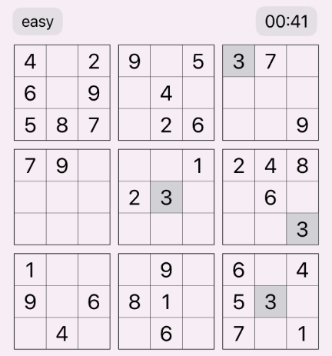
Game of Sudoku
Sudoku means “single number” in Japanese.
A logic-based puzzle where you place digits 1–9 so each row, column, and 3×3 box contains each digit exactly once.
Easy Sudoku For Kids 3x3

Slide 10
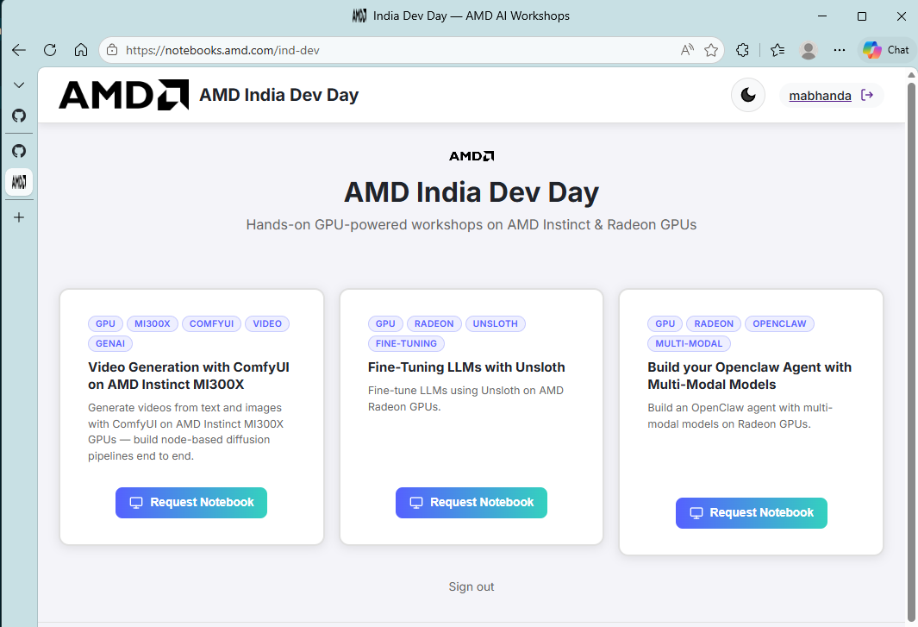
AMD UnSloth Fine-Tuning Workshop
https://notebooks.amd.com/ind-dev
Brings you to an AMD Radeon GPU hosted Jupyter notebook
Password: RadeonUnslothTuning

Slide 11
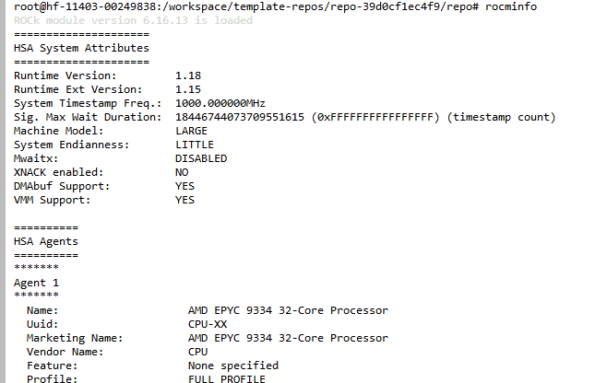
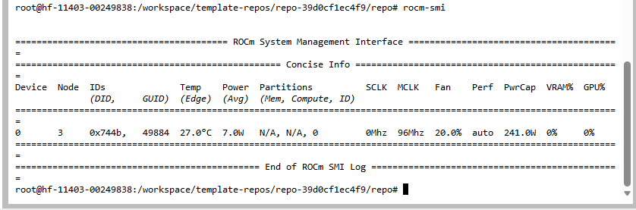
GPU – visibility & health
In a terminal execute
>rocm-smi
>rocminfo

Slide 12
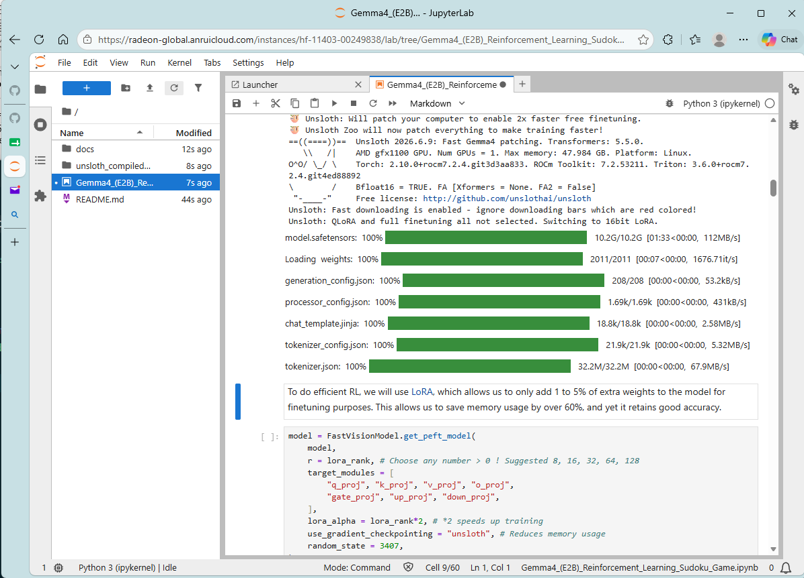
Jupyter Cells
Wait for cells to complete (*) -> (n)
Watch GPU use with rocm-smi

Slide 13
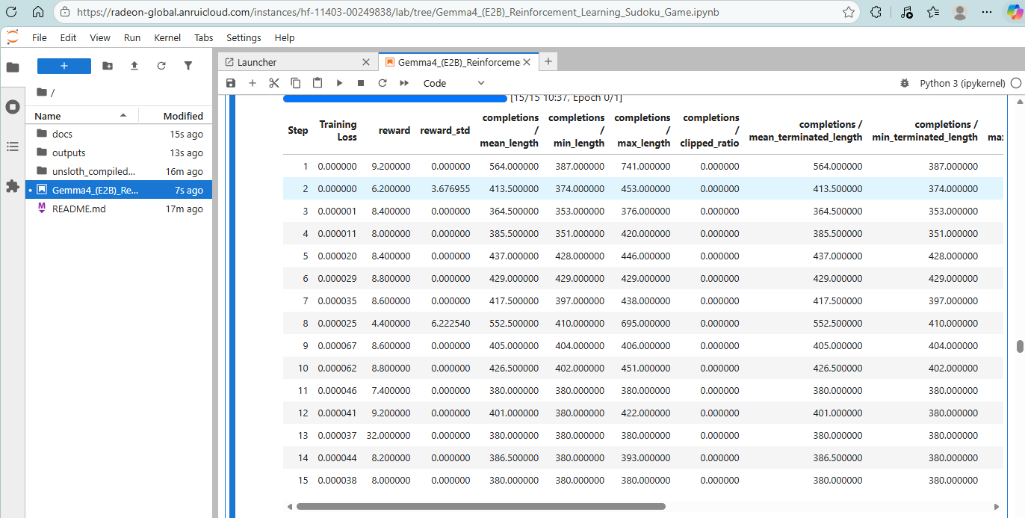
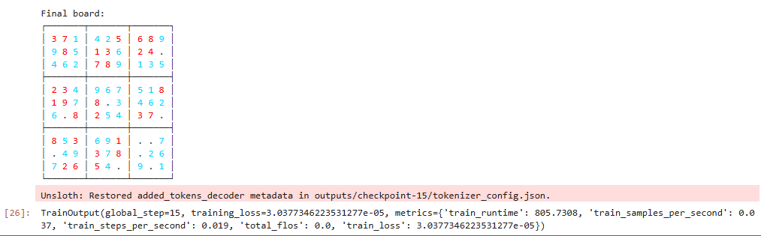
Fine-Tuning Complete!
Demo: 15 steps

Slide 14
Fine-Tuning Trouble Shooting Tips
Symptom | Fix
First chat response times out | Cold model load. Retry; the warm model responds faster
Training data format issues | Check it. Use Alpaca fields {"instruction": "Summarize in one line.", "input": "<article text>", "output": "<summary>"} {"instruction": "Translate to French.", "input": "Good morning", "output": "Bonjour"}
Out-of-memory during training | Use a smaller model, enable QLoRA (4-bit), lower batch size or sequence length
Loss not decreasing | Raise learning rate a little, train more streps, or check that your dataset format is correct
Cell not completing | In a terminal execute rocm-smi to see GPU, memory usage. GPU use drops to zero when done training.
Need good first experiment ideas? | Use SFT initially to speed learning. HF has data sets Try product related finetuning with Q&A pairs GRPO – explore a math dataset where correct answers available

Slide 15
Learn More!
Unsloth: https://github.com/unslothai/unsloth
Unsloth docs: https://docs.unsloth.ai
LoRA paper: https://arxiv.org/abs/2106.09685
QLoRA paper: https://arxiv.org/abs/2305.14314
GRPO / DeepSeekMath: https://arxiv.org/abs/2402.03300

